Slide 1

Software Project Management
By :Mrs.Priya Pawar

Slide 2
What is a Project?
A project is a temporary endeavor undertaken to produce a unique product or service
Temporary
Characteristics of
Projects
Unique
Temporary – Definitive beginning and end
Unique – New undertaking, unfamiliar ground

Slide 3
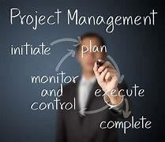
Project in Detail :
Project in general refers to a new endeavor with specific objective Some of the definitions are as follows.
Project is a temporary endeavor undertaken to create a unique product or service or result.
Project is a unique process, consist of a set of coordinated and controlled activities with start and finish dates, undertaken to achieve an objective confirming to specific requirements, including the constraints of time cost and resource.

Slide 4
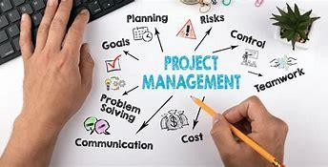
Project Management
Project Management is the process of planning, directing, and controlling the development of an acceptable system at a minimum cost within a specified time frame
Project management is necessary because of
The number of people involved
The number of tasks to be done
The extent of the interaction between the tasks and people
The complexity of the interactions between the tasks and people

Slide 5
What is Project Management
Project Management is the application of skills, knowledge, tools and techniques to meet the needs and expectations of stakeholders for a project.
The purpose of project management is prediction and prevention, NOT recognition and reaction
Project management activities Defining tasks and the dependencies between them
Allocating people and resources to tasks
Monitoring progress of project against plan
Taking remedial action when things dont go according to plan

Slide 6
Basic Process of Project Management
Select Systems development approach/methodology
Plan the project tasks
Estimate the resources and time required to complete individual phases of the project
Staff the project team
Organize and schedule the project effort(tasks/time/ people/technical resources)and therefore cost
Control the project development (directing the team, controlling progress, replan, restaff

Slide 7




Triple Contraint
Time
Quality
Cost
Scope

Slide 8
Triple Contraint
Increased Scope = increased time + increased cost
Tight Time = increased costs + reduced scope
Tight Budget = increased time + reduced scope.

Slide 9

Key Areas of Project Management
Scope Management
Issue Management
Cost Management
Quality Management
Communications Management
Risk Management
Change Control Management

Slide 10
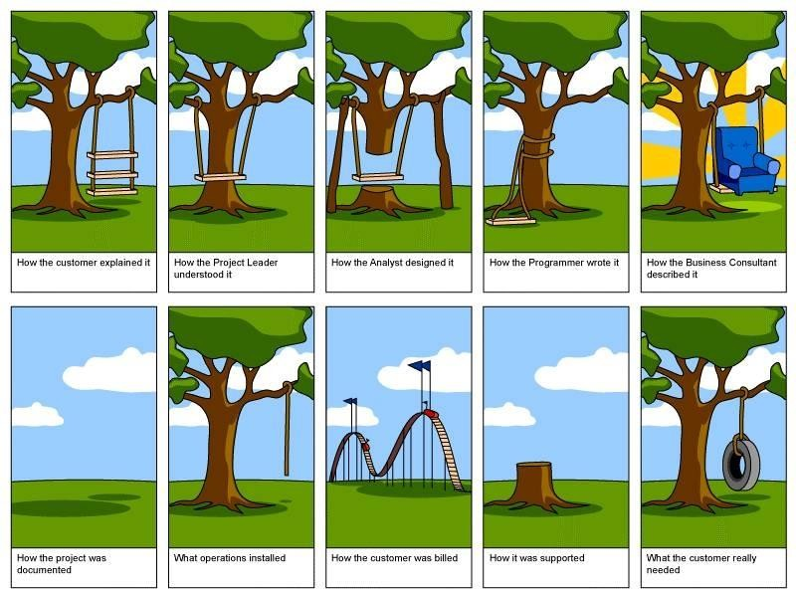

Slide 11




Scope Management
Primarily it is the definition and control of what IS and
IS NOT included in the project.

Slide 12

Issue Management
Issues are restraints to accomplishing the deliverables of the project.
Typically identified throughout the project and logged and tracked through resolution.
Issue… already impacting the cost, time or quality
Rope not thick

Slide 13




Cost Management
This process is required to ensure the project is completed within the approved budget and includes:
Resources people equipment materials
Quantities
Budget

Slide 14

Quality Management
Quality Management is the process that insure the project will meet the needs

Slide 15



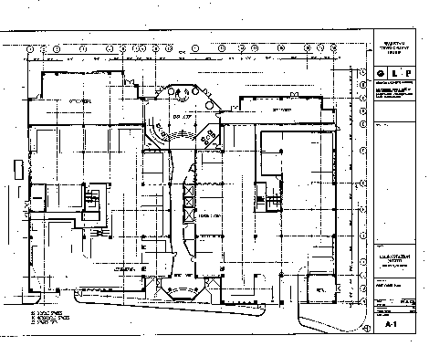
Communications Management
This process is necessary to ensure timely and appropriate generation, collection, dissemination, and storage of project information

Slide 16


Risk Management
Risk identification and mitigation strategy
Risk update and tracking
Risk… POTENTIAL negative impact to project
Tree – location, accessibility, ownership
Weather

Slide 17



Change Control Management
Define how changes to the project scope will be executed
Scope Change
Technical Specification Changes
Schedule changes
All changes require collaboration and buy in via the project sponsor’s signature prior to implementation of the changes

Slide 18
Project Life Cycle
Initiation Phase
Definition Phase
Planning Phase
Implementation Phase
Deployment Phase
Closing Phase

Slide 19

Initiation Phase
Define the need
Return on Investment Analysis
Make or Buy Decision
Budget Development

Slide 20

Definition Phase
Determine goals, scope and project constraints
Identify members and their roles
Define communication channels, methods, frequency and content
Risk management planning

Slide 21

Planning Phase
Resource Planning
Work Breakdown Structure
Project Schedule Development
Quality Assurance Plan

Slide 22
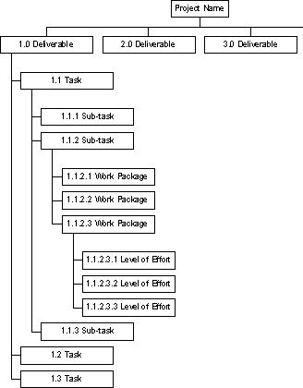
Work Breakdown Structure
For defining and organizing the total scope of a project
First two levels - define a set of planned outcomes that collectively and exclusively represent 100% of the project scope.
Subsequent levels - represent 100% of the scope of their parent node

Slide 23

Implementation Phase
Execute project plan and accomplish project goals
Training Plan
System Build
Quality Assurance

Slide 24

Deployment Phase
User Training
Production Review
Start Using

Slide 25
Closing Phase
Contractual Closeout
Post Production Transition
Lessons Learned

Slide 26
Project Management Tools and Techniques
Deliverables - To check what has been done
Milestones - To check where we have got to (and how far to go)
PERT Charts - To show the connections between tasks
Gantt Charts - To show progress on tasks (milestones)

Slide 27

Project Success
Customer Requirements
satisfied/exceeded
Completed within allocated
time frame
Completed within allocated budget
Accepted by the customer

Slide 28
Project Failure
Scope Creep
Poor Requirements Gathering
Unrealistic planning and scheduling
Lack of resources

Slide 29
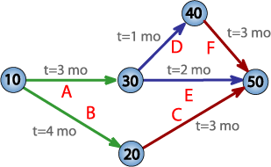
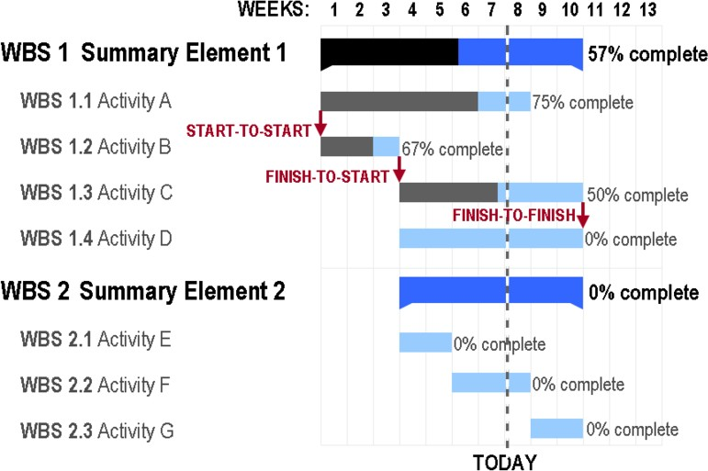
Project Management Tools
PERT Chart- designed to analyze and represent the tasks involved in completing a given project
Gantt Chart - popular type of bar chart that illustrates a project schedule

Slide 30

Role of a Project Manager
Project issues
Disseminating project information
Mitigating project risk
Quality
Managing scope
Metrics
Managing the overall work plan
Implementing standard processes
Establishing leadership skills
Setting expectations
Team building
Communicator skills
Process Responsibilities
People Responsibilities

Slide 31
Gantt Chart

Slide 32
PERT Chart

Slide 33
Scope Management
Project Scope Management is the process to ensure that the project is inclusive of all the work required, and only the work required, for successful completion.
Primarily it is the definition and control of what IS and
IS NOT included in the project.

Slide 34
Issue Management
Issues are restraints to accomplishing the deliverables of the project.
Issues are typically identified throughout the project and logged and tracked through resolution.
In this section of the plan the following processes are depicted:
Where issues will be maintained and tracked
The process for updating issues regularly
The escalation process
The vehicle by which team members can access documented issues

Slide 35
Cost Management
This process is required to ensure the project is completed within the approved budget and includes:
Resource Planning - The physical resources required (people, equipment, materials) and what quantities are necessary for the project
Budget
Budget estimates
Baseline estimates
Project Actuals

Slide 36
Quality Management
Quality Management is the process that insure the project will meet the needs via:
Quality Planning, Quality Assurance, and Quality Control
Clearly Defined Quality Performance Standards
How those Quality and Performance Standards are measured and satisfied
How Testing and Quality Assurance Processes will ensure standards are satisfied
Continuous ongoing quality control

Slide 37
Communications Management
This process is necessary to ensure timely and appropriate generation, collection, dissemination, and storage of project information using:
Communications planning
Information Distribution
Performance Reporting
Define the schedule for the Project Meetings (Team, OSC, ESC), Status Meetings and Issues Meetings to be implemented

Slide 38
Risk Management
Risk identification and mitigation strategy
When\if new risks arise
Risk update and tracking

Slide 39
Change Control Management
Define how changes to the project scope will be executed
Formal change control is required for all of the following
Scope Change
Schedule changes
Technical Specification Changes
Training Changes
All changes require collaboration and buy in via the project sponsor’s signature
prior to implementation of the changes

Slide 40
Causes of Failed projects
Poor management of users expectations
Scope may change (uncontrolled) .. schedule and budget stay the same
Cost overruns schedule delays
Early estimates with little information .. set in concrete, poor estimating skills
Inadequate/incorrect requirements specification
Design flaws

Slide 41
Quality metrics :
Software quality metrics are a subset of software metrics that focus on the quality aspects of the product, process, and project. These are more closely associated with process and product metrics than with project metrics.
Software quality metrics can be further divided into three categories
Product quality metrics
In-process quality metrics
Maintenance quality metrics

Slide 42
Product Quality Metrics :This metrics include the following Mean Time to Failure Defect Density Customer Problems Customer Satisfaction
Customer satisfaction is often measured by customer survey data through the five-point scale −
Very satisfied
Satisfied Neutral Dissatisfied Very dissatisfied
.

Slide 43
Based on the five-point-scale data, several metrics with slight variations can be constructed and used, depending on the purpose of analysis. For example
Percent of completely satisfied customers
Percent of satisfied customers
Percent of dis-satisfied customers
Percent of non-satisfied customers

Slide 44
Maintenance Quality Metrics
Although much cannot be done to alter the quality of the product during this phase, following are the fixes that can be carried out to eliminate the defects as soon as possible with excellent fix quality.
Fix backlog and backlog management index
Fix response time and fix responsiveness
Percent delinquent fixes
Fix quality
Fix backlog

Slide 45
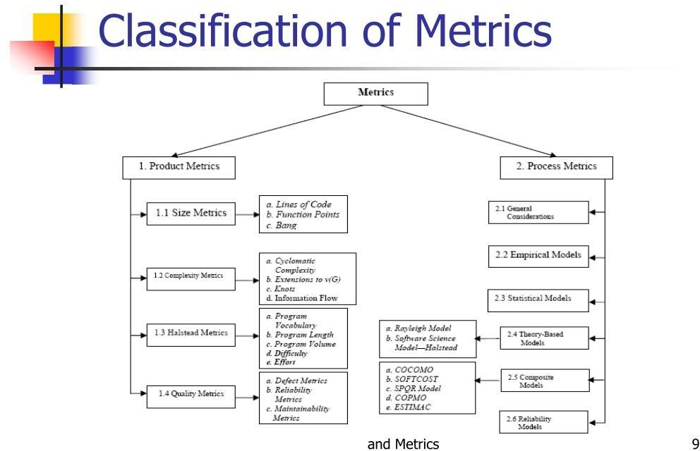

Slide 46
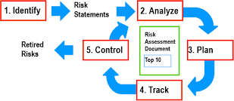
Risk Management Process
Project risk is the potential of a project to fail. There are three main types of project risks: Cost, schedule, and Performance.
Steps of the Risk Management Process
Identify the risk.
Analyze the risk.
Prioritize the risk.
Treat the risk.
Monitor the risk.

Slide 47
Risk Management Process
As a project manager or team member, you manage risk on a daily basis; it’s one of the most important things you do.
Apply a systematic risk management process, and put into action the core 5 risk management process steps

Slide 48
Risk Management Process Steps
Step 1: Identify the Risk. Team should uncover, recognize and describe risks that might affect your project or its outcomes. There are a number of techniques you can use to find project risks. During this step you start to prepare your Project Risk Register.
Step 2: Analyze the risk. Once risks are identified you determine the likelihood and consequence of each risk. You develop an understanding of the nature of the risk and its potential to affect project goals and objectives. This information is also input to your Project Risk Register.
Step 3: Evaluate or Rank the Risk. Evaluate or rank the risk by determining the risk magnitude, which is the combination of likelihood and consequence. You make decisions about whether the risk is acceptable or whether it is serious enough to warrant treatment. These risk rankings are also added to your Project Risk Register.
Step 4: Treat the Risk. This is also referred to as Risk Response Planning. During this step you assess your highest ranked risks and set out a plan to treat or modify these risks to achieve acceptable risk levels. How can you minimize the probability of the negative risks as well as enhancing the opportunities? You create risk mitigation strategies, preventive plans and contingency plans in this step. And you add the risk treatment measures for the highest ranking or most serious risks to
your Project Risk Register.
Step 5: Monitor and Review the risk. This is the step where you take your Project Risk Register and use it to monitor, track and review risks.

Slide 49
Risk Identification
Risk Identification involves:
Identifying risks that may occur on a particular project
Determining which risks might affect the project
Documenting their characteristics

Slide 50
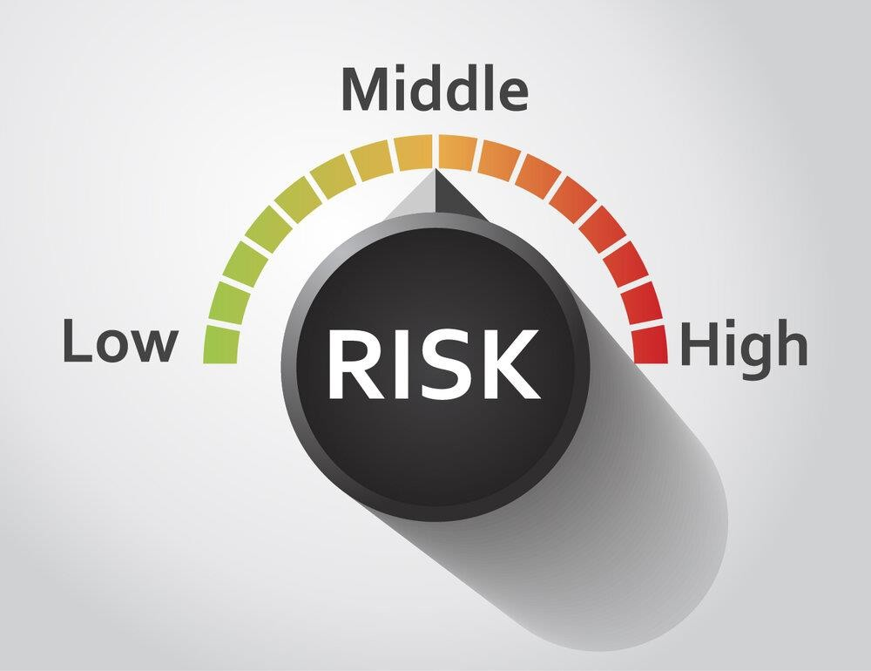
Importance of Risk Management
By identifying and analyzing potential threats to your organization, such a process mitigates the impact of any negative events
8 Benefits of Risk Management
It's easier to spot projects in trouble.
There are fewer surprises.
There's better quality data for decision making.
Communication is elevated.
Budgets rely less on guesswork.
The expectation of success is set.
The team remains focused.
Escalations are clearer and easier.

Slide 51
A Risk Management Plan :A defined and documented process agreed upon by project stakeholders for how risks will be identified, assessed, a decision made on mitigation (or if the risks will be accepted), how a response plan will be developed and what controls will be put in place to monitor risks over the duration of the project.
Identify Risks – Capture Form A way to efficiently capture identified project risks and add to the Register.
Risk Register A log of identified risks and their status.
Qualitative / Quantitative Analysis Tools : Methods for analysing / evaluating the
probability and impact of risks on the project objectives.

Slide 52
Response / Mitigation Plan :Determine if the risks are acceptable or not based on assessment and plan for mitigation.
Control Risks :Assess effectiveness through methods like risk audits and continually improve your project execution.
Risk Register Example
A typical register may look like the table below. Risks are added to the register as they are identified and the impact and probability of occurrence are assessed through qualitative and quantitative methods.

Slide 53
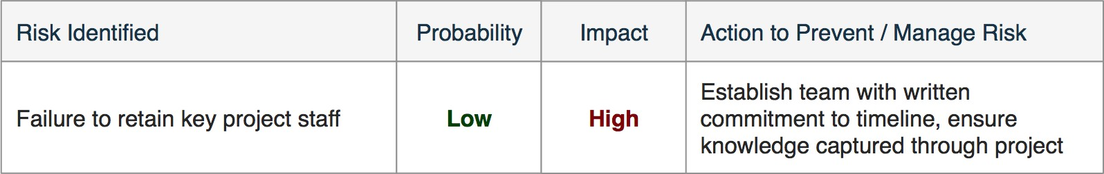
Quantitative Risk Assessment :Qualitative assessment is an objective numerical probabilistic
assessment of impact and probability of factors.
There are many methodologies available some examples include:
Critical Path Method
Fault Tree Analysis
Monte Carlo Simulation
Sensitivity Analysis
FMEA

Slide 54
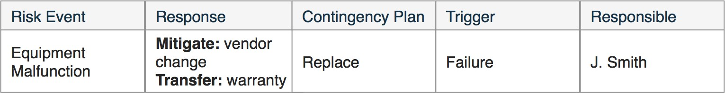
Risk Mitigation
The objective of risk mitigation is to reduce the probability and/or consequences of a risk event to an acceptable threshold and define appropriate response.
Questions To Ask:
What are the available options?
Tradeoffs (cost / benefit) of each option?
Impacts of current decisions on options?
Risk mitigation actions may be costly and time consuming; actions taken are balanced against priority level of the risk. Organizations typically transfer risk where possible, for example through product warranty.
Low-risk factors may be recognized by the Organization but absorbed as a matter of policy.

Slide 55
Risk Mitigation, Monitoring, and Management (RMMM) plan
A risk management technique is usually seen in the software Project plan. This can be divided into Risk Mitigation, Monitoring, and Management Plan (RMMM).
Risk Mitigation :
It is an activity used to avoid problems (Risk Avoidance). Steps for mitigating the risks as follows.
Finding out the risk.
Removing causes that are the reason for risk creation.
Controlling the corresponding documents from time to time.
Conducting timely reviews to speed up the work.

Slide 56
Risk Monitoring : It is an activity used for project tracking.
It has the following primary objectives as follows.
To check if predicted risks occur or not.
To ensure proper application of risk aversion steps defined for risk. To collect data for future risk analysis.
To allocate what problems are caused by which risks throughout the project
Risk Management and planning :
It assumes that the mitigation activity failed and the risk is a reality.
This task is done by Project manager when risk becomes reality and causes severe problems. If the project manager effectively uses project mitigation to remove risks successfully then it is easier to manage the risks.
This shows that the response that will be taken for each risk by a manager. The main objective of the risk management plan is the risk register. This risk register describes and focuses on the predicted threats to a software project.

Slide 57


